Slide 1
Optimizing E-Commerce Operations in Türkiye
A Data-Driven Analysis of Logistics & Loyalty
group 28
Team Members:
Barış Arslan
Oğuz kerem Ayhan
Ali Tuğrul Akıcı
Batuhan Ayranlı

Slide 2
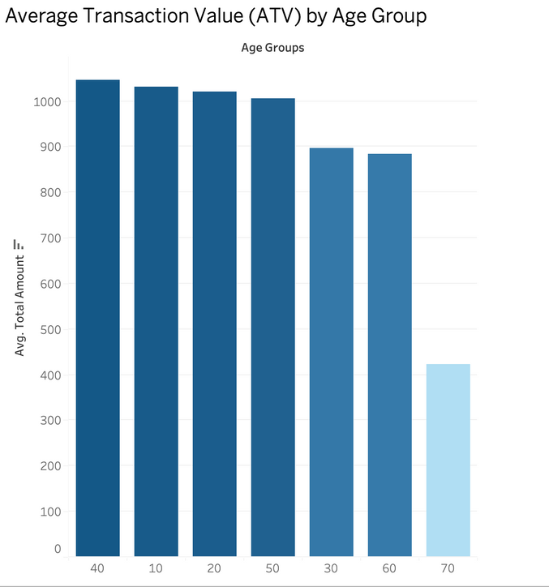
Is there a "Prime Spending Age" where Transaction Value peaks, and where does the sharp drop-off begin?
The data reveals a consistent high-spending plateau across the 40s, 10s, 20s, and 50s. Interestingly, the youngest (10s, 20s) and middle-aged (40s, 50s) groups share a similar Average Transaction Value (ATV), consistently exceeding the 1,000₺ threshold.
While the 30s and 60s show a slight decrease, the most significant insight comes from the 70s age group. Here, we see a drastic decline (more than 50% drop compared to the top performers), indicating a major shift in purchasing behavior or budget constraints for this demographic.
So, the "Sweet Spot" for maximizing transaction value is broad, covering ages from 10 to 50, but the 70s group represents a clear outlier with significantly lower spending power, suggesting they are not the primary target for high-value items.

Slide 3
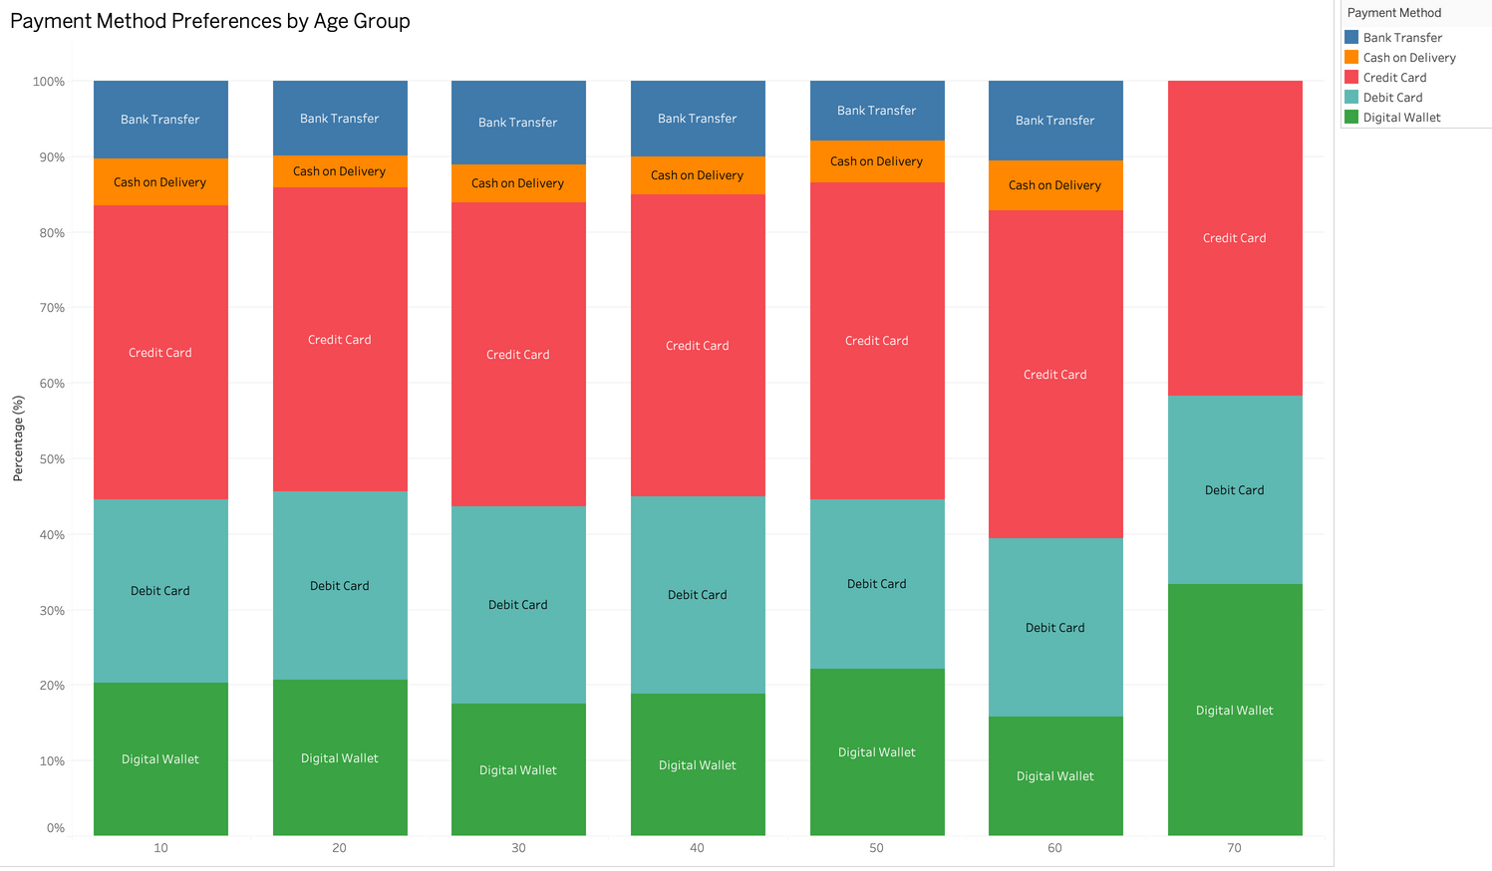
Does Age Dictate Payment Preference? An Analysis of Transactional Behavior Across Generations
The data exhibits remarkable transactional homogeneity across the 10-60 age cohorts, where Credit Cards dominate alongside a persistent reliance on 'Bank Transfer' and 'Cash on Delivery'. Conversely, a significant statistical deviation occurs within the 70 age cohort, which entirely eliminates these legacy methods. Surprisingly, this senior demographic demonstrates the highest adoption of Digital Wallets (>30%), challenging conventional stereotypes of geriatric fintech resistance by prioritizing frictionless electronic settlements over traditional logistical complexity.
This analysis invalidates the operational assumption that legacy payment gateways like 'Cash on Delivery' are requisite for older users. Businesses can confidently streamline operations by reducing cash logistics overhead, as the senior demographic has fully pivoted to digital channels. Consequently, strategic investment should prioritize Digital Wallet accessibility rather than maintaining outdated infrastructure for this segment.

Slide 4
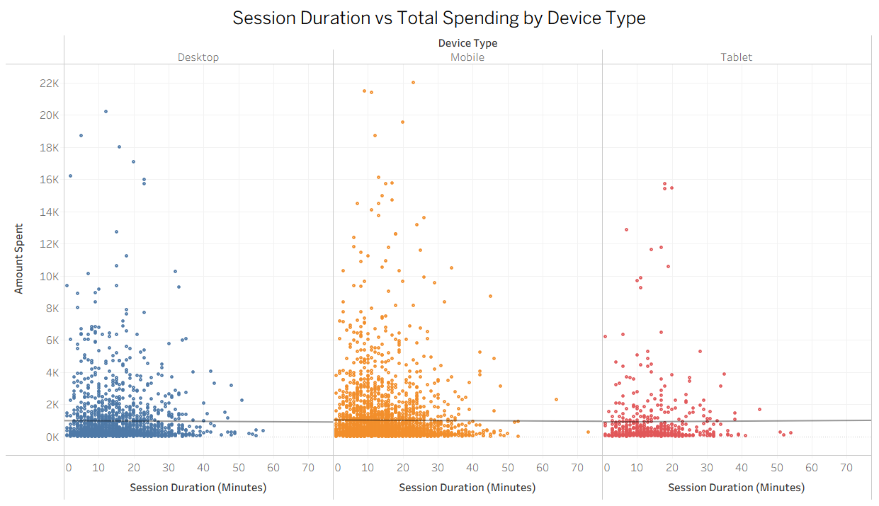
Does the Session Duration correlate with the Total Amount spent and how does this relationship vary by Device Type?
The lines’ p-values (0.83, 0.82, 0.90) are all very high, meaning none of the slopes are statistically significant.
The coefficients vary slightly in direction (some negative, some positive), but the effects are insignificant.
This indicates that session length does not reliably impact spending which means average spending stays roughly the same regardless of session length.
In conclusion all three regression lines show no significant relationship between session duration and total spending.
Session duration does not affect total spending, and this is consistent across all device types.

Slide 5
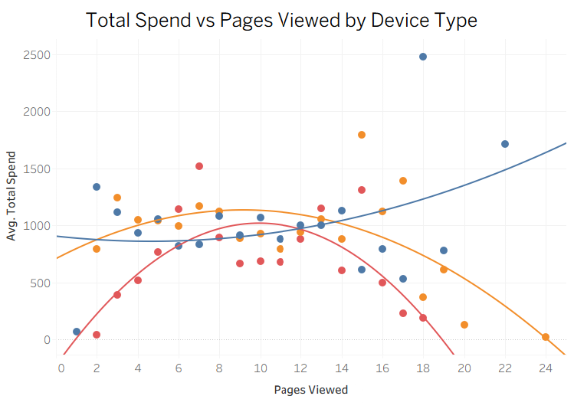

Is there a "Sweet Spot" for Pages Viewed where Total Spend is maximized,
and does this behavior differ for different device type users?
The correlation line for desktop shows that there isnt an optimal number of pages viewed and the spend mostly increases as pages viewed increases.
But as we can see from the nonlinear correlation lines for mobile and tablet the spending is maximized not by viewing the most pages, instead viewing an optimal number of pages.
Device Type | Optimal Pages Viewed
Mobile (Orange) | Around 8 to 10 Pages
Tablet (Red) | Around 10 Pages
So there is a sweet spot for average spend for mobile(around 9 pages) and tablet(around 10 pages)
but desktop’s average spend increases as the pages viewed increases therefore it has no sweet spot.

Slide 6

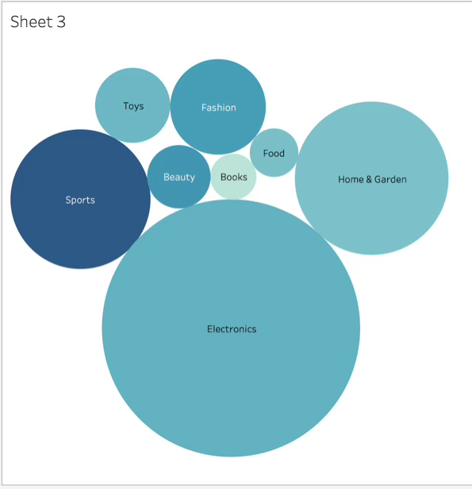
FINANCIAL & MARKETİN STRATEGY
RQ: Does offering a higher discount amount lead to a larger Basket size (Quantity, and does this strategy work better for Fashion vs. Electronics?
Goal: Determine if discounts drive volume or just reduce margin.
Variables: Discount_Amount, Quantity, Product_Category
.
Interpretation: This is a bubble chart. It shows the relationship between two numeric and one categoric variables. Discount amount represented by bubble size. As we see the graph electronic products have most discount amount. Books and Food have less ones. Also, quanity amount is represented by color tone, which means darkest blue have most quantity. In this graph sports have most quantity and books have less quantity.

Slide 7
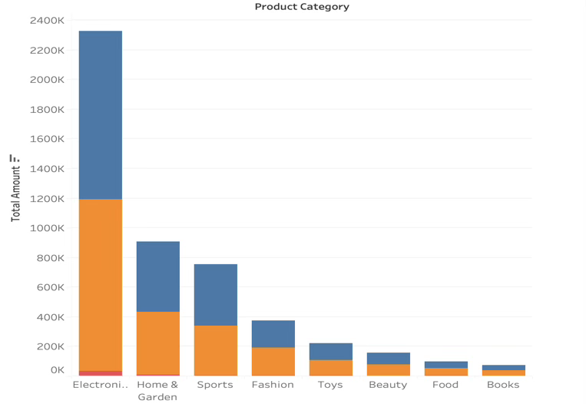
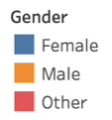
Which product Categories generate the most Total Revenue,
and is there a significant difference in preference between Genders?
RQ: Which product Categories generate the most Total Revenue, and is there a significant difference in preference between Genders?
Goal: Identify “Cash Cow” products and target audience segments.
Variables: Product_Category, Total_Amount, Gender
.
Interpretation: It is a Stacked bar chart. It indicates relationship between 2 categoric and 1 numeric variable. Gender represents colors blue, orange and red. As we see electronic products have more total amount than others. Moreover, among the renders electronic products are most preferred. If we look distribution of the graph male and female share products almost equally proportion. However, male are slightly more in food and books classes.

Slide 8
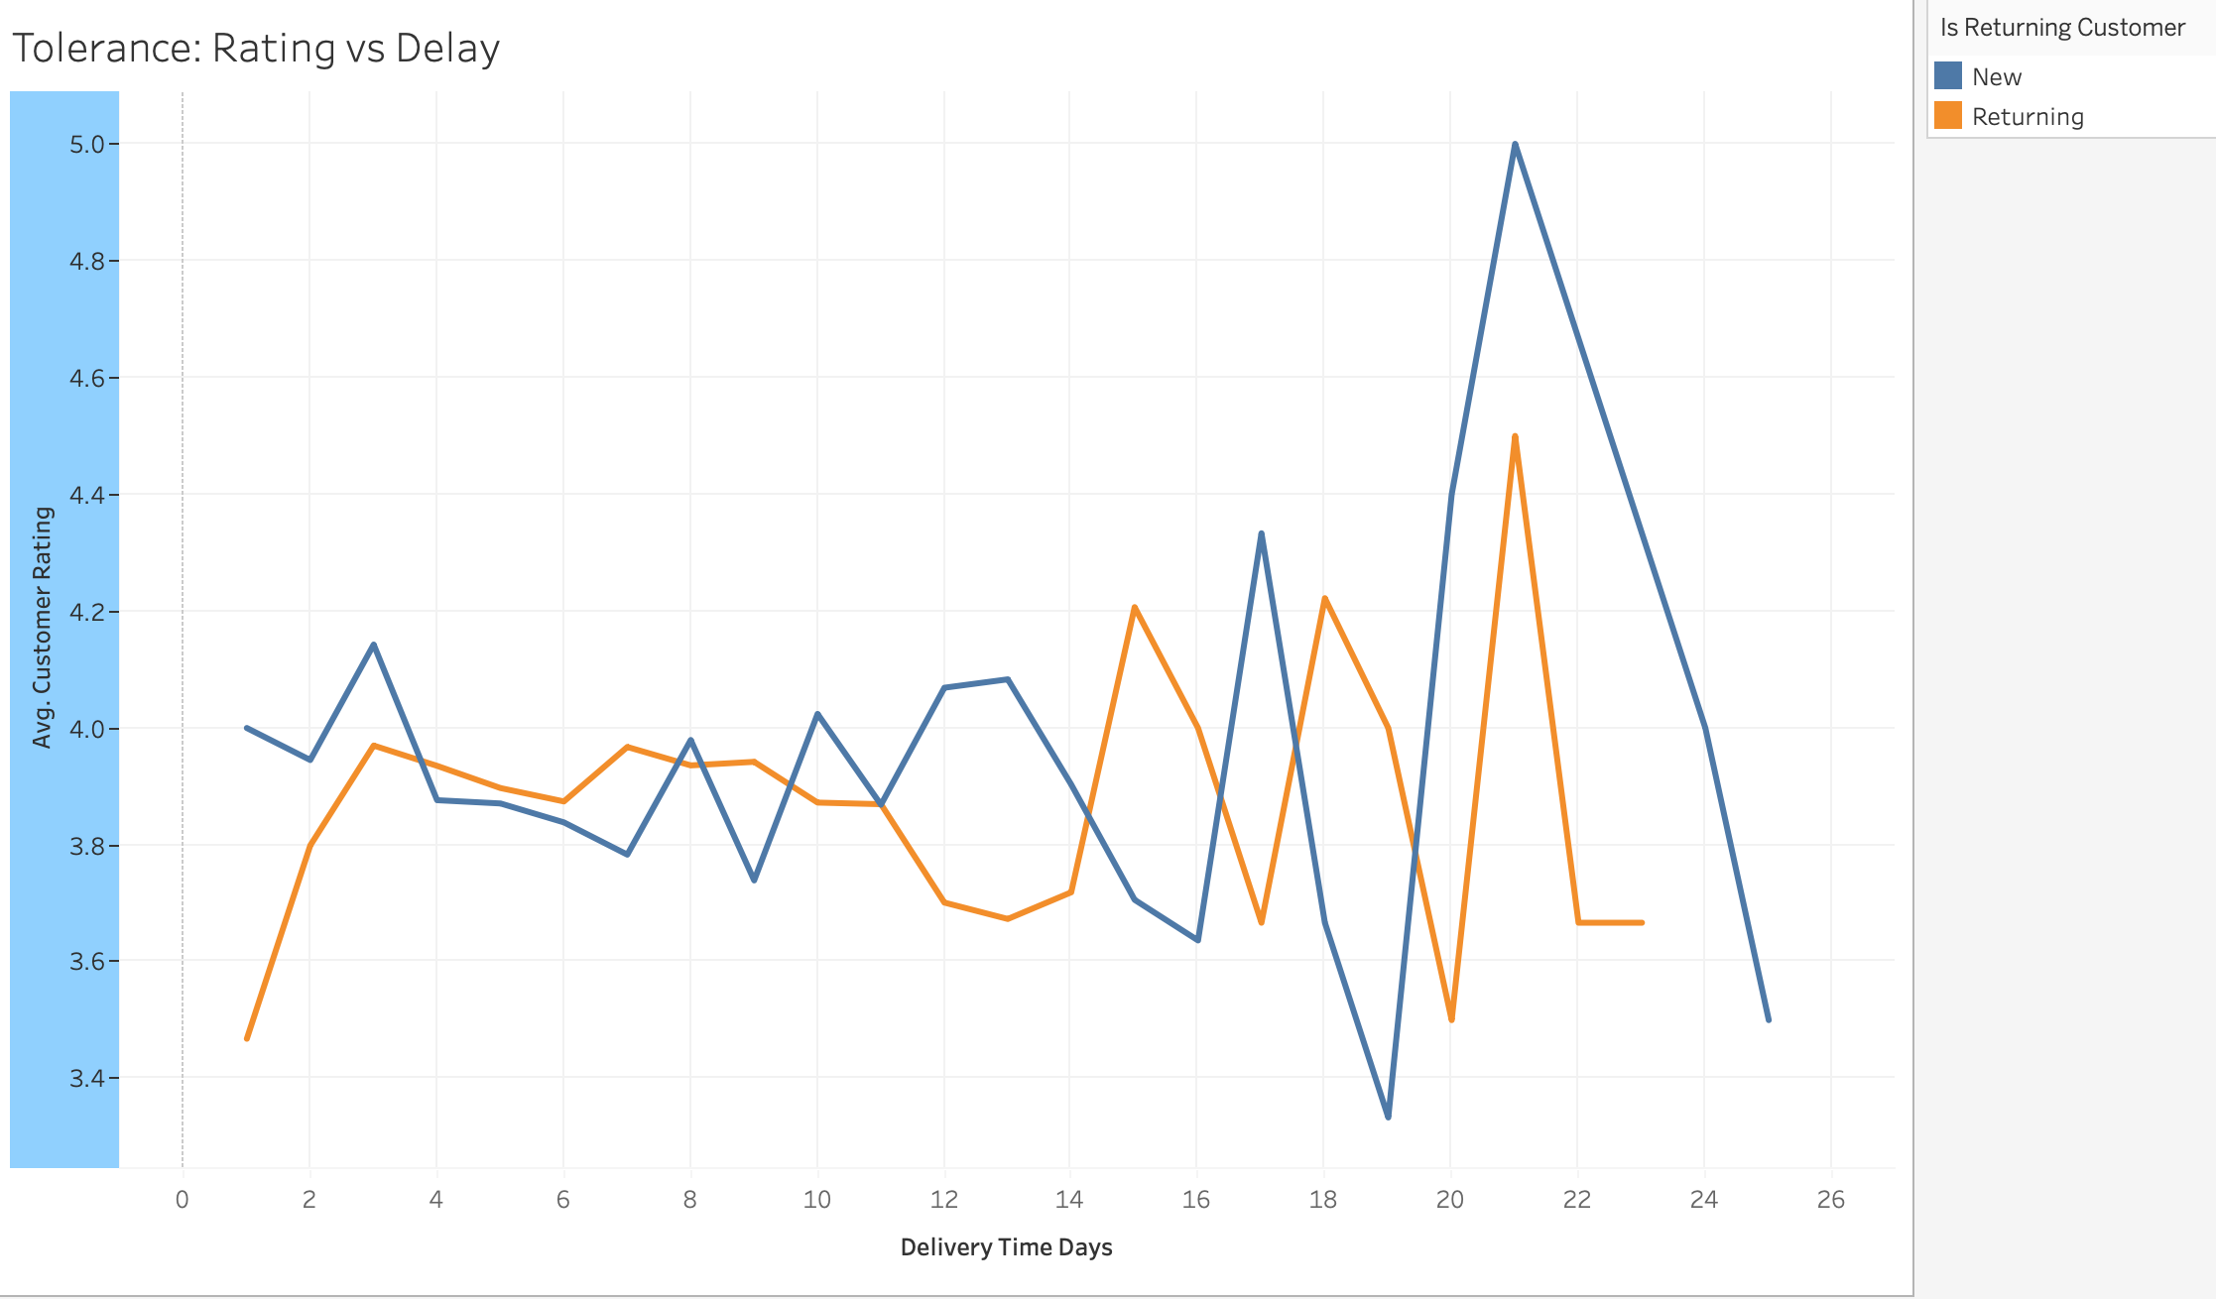
How significantly does Delivery Time impact Customer Rating?
-Delivery time doesn't strictly hurt ratings until it gets very long (20+ days).
-People seem patient for the first 1-2 weeks
Interpretation: For standard deliveries (0-2 weeks), New and Returning customers are equally happy. However, when operational disasters happen and delivery takes 19+ days, New Customers (Blue line) react negatively, dropping their ratings sharply. In contrast, Returning Customers (Orange line) show higher patience. Even at 19-23 days of delay, their satisfaction remains relatively stable around 3.6 to 4.0. They trust the brand enough to forgive a single bad experience, whereas New Customers do not.

Slide 9
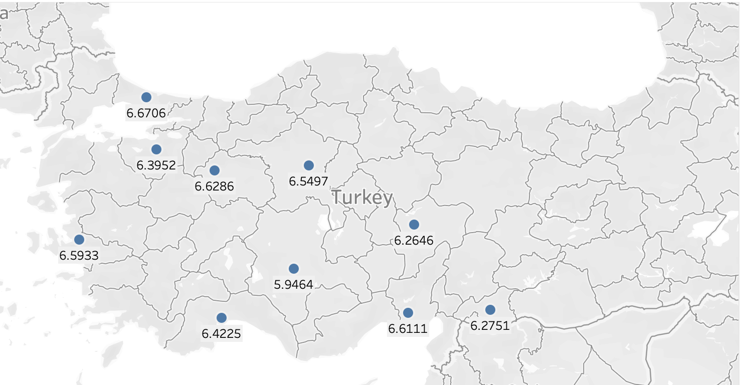
Which Cities are experiencing the longest delays?
Istanbul seems to be the slowest (Avg ~6.67 days), followed closely by Eskisehir.
Interpretation:
-The Bottleneck (Istanbul): Istanbul is the slowest region with an average delivery time of 6.67 days. This is a critical finding because the largest market is receiving the slowest service.
-The Benchmark (Konya): Konya is the most efficient city with an average time of 5.95 days, performing nearly a full day faster than Istanbul.

Slide 10
